Slide 1
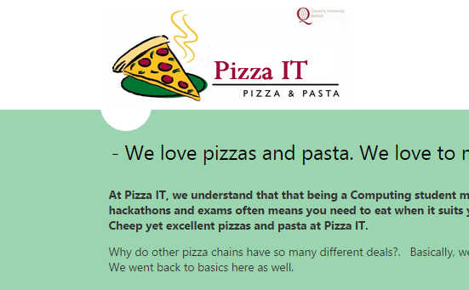
About
No user input sections
Mostly textual information
Only 2 cosmetic defects encountered
Missing Title

Slide 2
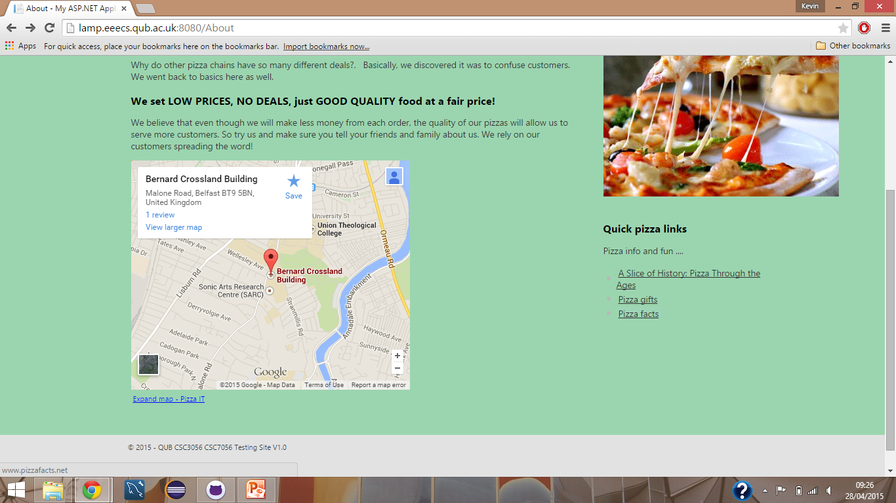
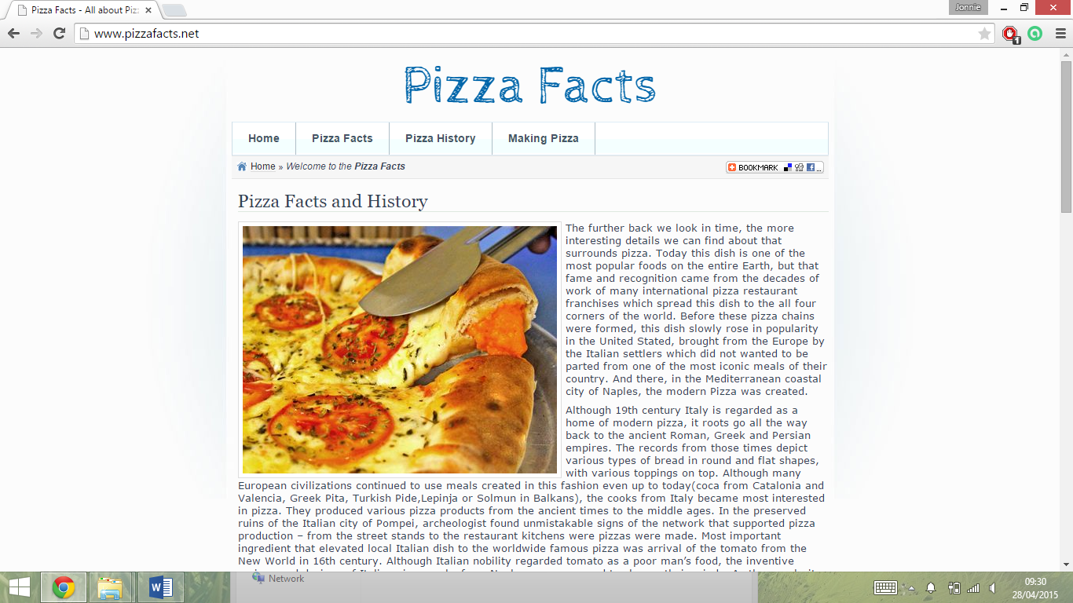
About
Selecting this should open a new tab/window

